Slide 1
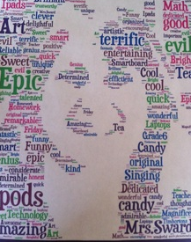
Kris Sward BA, BEd, MEdl
Digital citizenship in the intermediate classroom

Slide 2
Welcome
Kris Sward
Grade 5/6
Chilliwack School District
Teaching for 9 years
Techie for three or four (it’s been an interesting journey!)
Educational Technology Facilitator in my District (one of a team of four)
Finished the OLTD program through VIU in June, 2015
Finished my Master’s project in September, 2015

Slide 3
So why am I here and why is there a need?
Twelve Surrey teens disciplined for sharing explicit photos of fellow students ~ The Province, April 17, 2015
Welcome to Shaw Webmail
We have detected some unusual activities Due to security protocols.
You can not receive new messages until you update your mailbox.
Your accounts has now been upgraded and needs to be updated.
It's a few step CLICK HERE to update now.
© 2015 All Rights
Reserved.
SeaWorld Responds To California Drought By Draining Animal Tanks Halfway ~ The Onion, April 18, 2015

Slide 4
Digital Citizenship must be:
Taught from an early age
Proactive not reactive
On ongoing and evolving discussion
Involve many stakeholders
Taught….not assumed
A priority in our society

Slide 5
Major Change…..came through summer school
Special Project Assignment - Summer School - Digital Literacy, Grades 4-6
Led me to find the Digital Literacy Framework put out in draft form by the Ministry of Education
https://www.bced.gov.bc.ca/dist_learning/docs/digital-literacy-framework-v3.pdf

Slide 6
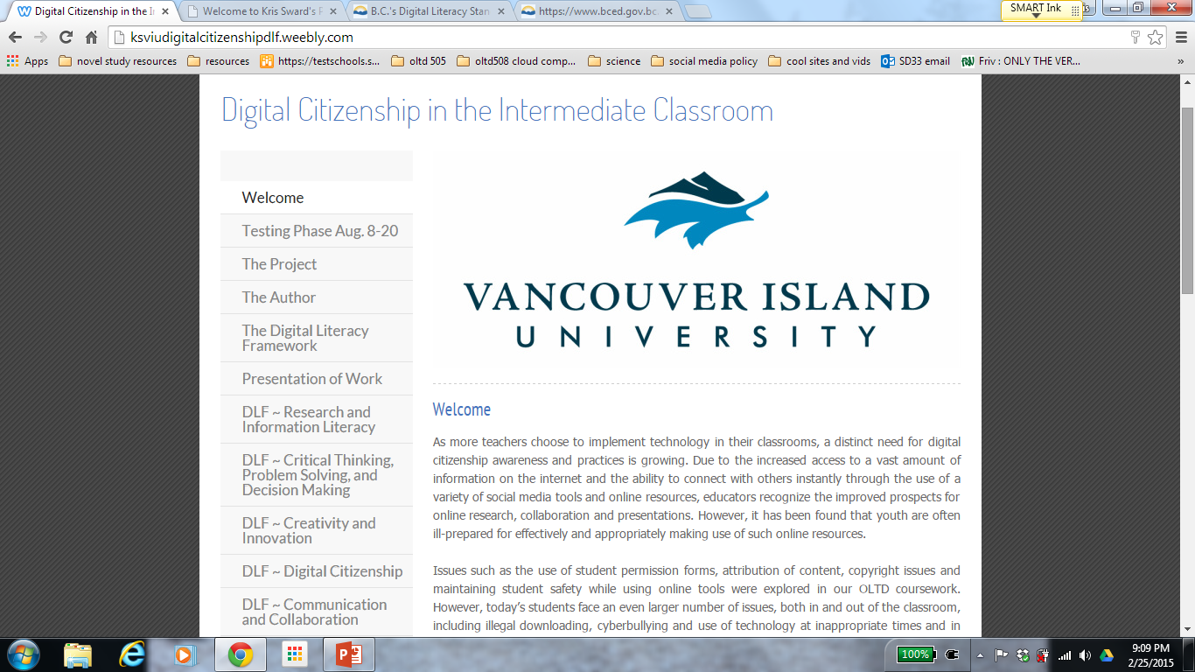
http://ksviudigitalcitizenshipdlf.weebly.com/
http://ksviudigitalcitizenshipdlf.weebly.com/

Slide 7
Standard format
Section of the DLF
(in this case: Technology Operations and Concepts)
Subsection (in this case: B: Use in Everyday Life
Outcome number
Each section and subsection contains the topic, a brief description of the purpose of the topic, numerous outcomes, proposed lesson plans and additional resources
Grade Range

Slide 8
Standard Lesson Plan used for all topics

Slide 9
Digital Literacy Framework:
1) Research and Information Literacy
2) Critical Thinking, Problem Solving and Decision Making
3) Creativity and Innovation
4) Digital Citizenship
5) Communication and Collaboration
6) Technology Operations and Concepts

Slide 10
Research and Information Literacy
A) Information Literacy - A digitally literate person uses the Internet to do research in an effective and responsible manner.
B) Information Processing and Management - A digitally literate person uses technology to improve his/her ability to gather, organize, analyze and judge the relevance and purpose of digital information.

Slide 11
Hoax Sites
RA1 – The student understands that anyone can publish on the Web, so not all sites are equally trustworthy. (K-9)
http://zapatopi.net/treeoctopus/
http://www.thedogisland.com/

Slide 12
Critical Thinking, Problem Solving and Decision Making
A) Specialized and Advanced Skills For Learning - A digitally literate person uses ICT (Information and Communication Technology) to improve his/her learning performance.

Slide 13
Measurement Unit
CTA5 – The student creates knowledge representations using digital media. (6-9)
(student presentation video removed for privacy)

Slide 14
Digital Citizenship
A) Internet Safety - A digitally literate person stays safe on the Internet by employing strategies such as distinguishing between inappropriate contact and positive connections.
B) Privacy and Security - A digitally literate person knows how to protect his/her privacy, respects the privacy of others, and employs strategies to maintain information and data security online.
C) Relationships and Communication - A digitally literate person understands the risks and benefits of developing online relationships and uses technology to communicate effectively and respectfully.
D) Cyberbullying - A digitally literate person recognizes cyberbullying and knows how to deal with it.
E) Digital Footprint and Reputation - A digitally literate person is aware that his/her activities on the Internet leave a permanent "digital footprint" or "trail" and behaves accordingly.
.

Slide 15
Digital Citizenship (continued)
F) Self-image and Identity - A digitally literate person understands the nature of self-image and identity in the online environment, how our perceptions of others and our social values may be manipulated, and that people may not be what or whom they appear to be online.
G) Creative Credit and Copyright - A digitally literate person respects other's ownership of their digital creations.
H) Legal and Ethical Aspects - A digitally literate person behaves appropriately and in a socially responsible way in digital environments, demonstrating awareness and knowledge of legal and ethical aspects on the use of ICT and digital content.
I) Balanced Attitude Towards Technology - A digitally literate person demonstrates an informed, open-minded, and balanced attitude towards information society and the use of digital technology, is curious, aware of opportunities and new developments, and is comfortable to explore and exploit them.
J) Understanding and Awareness of the Role of ICT in Society - A digitally literate person understands the broader context of use and development of information and communication technology

Slide 16
Webonauts
DA1 – The student understands that he/she can go to exciting places online, but needs to follow certain rules to remain safe. (K-2)
http://pbskids.org/webonauts/

Slide 17
Digital Footprint
https://www.priv.gc.ca/youth-jeunes/fs-fi/res/gn_e.pdf
https://www.commonsensemedia.org/educators/lesson/trillion-dollar-footprint-6-8

Slide 18
Everfi.com
New resource – sponsored by NHL – free for teachers here today ☺
Not just digital citizenship, but that is a major focus
Many themes and topics are available….new to Canada

Slide 21
Everfi
https://platform.everfi.net/registration/login

Slide 22
Everfi
Email: Felisha Martin: felisha@everfi.com
@FelishaEverFi 604-499-6562
For your own login and codes for your school

Slide 23
Communication and Collaboration
A) Technology Mediated Communication and Collaboration - A digitally literate person connects, shares, communicates, and collaborates with others effectively in digital environments.

Slide 24
Collaborative Ebooks
CCA1 – The student communicates effectively by email, takes into account the purpose and audience of his/her message, and the tone he/she wants to convey. (K-2)
Legends Project Using Skype, Wikispaces, Googledocs to collaborate across schools and districts to co-create content

Slide 25
Technology Operations and Concepts
A) General Knowledge and Functional Skills - A digitally literate person knows the basics (terminology, navigation, functionality) of digital devices and can use them for elementary purposes.
B) Use in Everyday Life - A digitally literate person integrates technologies into the activities of everyday life.
C) Informed Decision Making - A digitally literate person is aware of most relevant or common technologies and is able to decide upon the most appropriate technology according to the purpose or need at hand.
D) Seamless Use Demonstrating Self-Efficacy - A digitally literate person confidently and creatively applies digital technologies to increase personal effectiveness and efficiency.
E) Learning About and With Digital Technologies - A digitally literate person actively and constantly explores emerging technologies, integrates them in his/her environment and uses them for lifelong learning.

Slide 26
Website ePortfolios
TB3 – The student searches, collects, process, evaluates, shares, and stores data and information using various devices, applications, or cloud services. (6-9)
www.education.weebly.com
http://clesmrssward.weebly.com/ Students can create their own ePortfolios using education.weebly.com

Slide 27
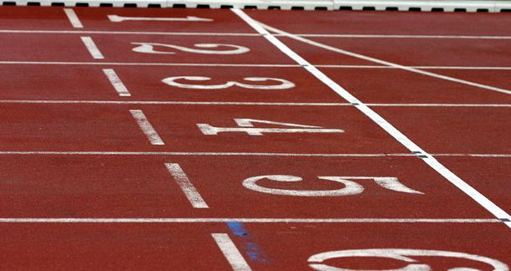
This is just a starting point….
Where do you want to go from here?
How can you change this material to suit your needs?
What can you implement tomorrow?

Slide 28
Response to e-incident
Flowchart
Developed for OLTD506

Slide 29
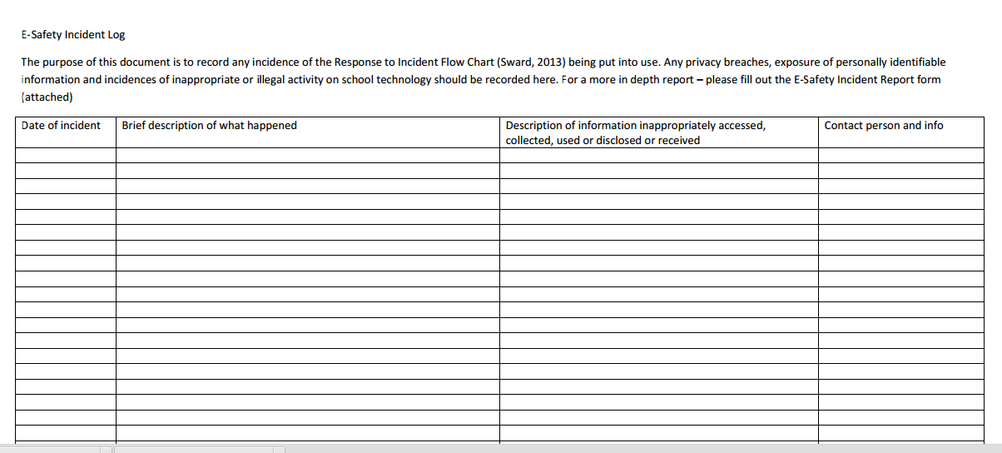

Slide 30
Questions?
Many thanks for taking the time to check out my work !

Slide 31
Need more info? Email: kristin_sward@sd33.bc.ca
Digital Citizenship in the Intermediate Classroom:
http://ksviudigitalcitizenshipdlf.weebly.com/

