Slide 1
Integrating Technology into the Curriculum
Scott Gregory and Kris Sward Yarrow and Cultus Lake

Slide 2
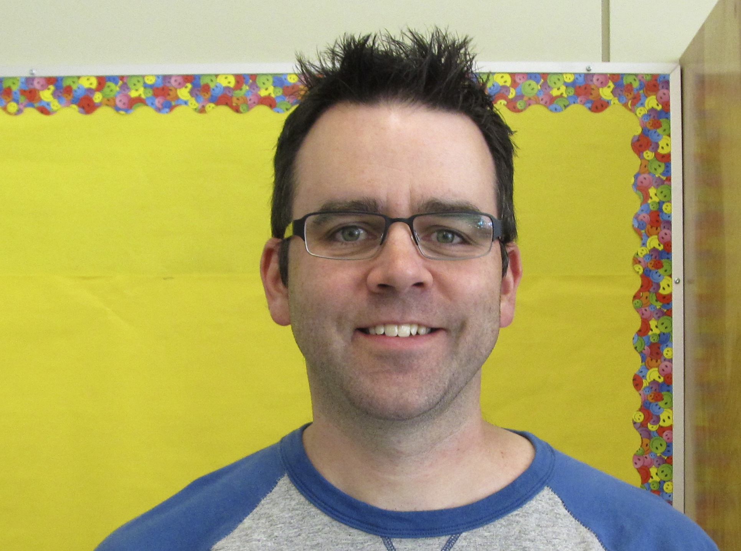
Scott Gregory
I have a lot of experience with developing projects that address learning outcomes across multiple subject areas in the grade 5 and 6 curriculum. Since a technology project can demand a significant time commitment, I found it important to have the projects that provide assessment in more than one subject area. I have an interest in projects that incorporate the following technology:
PowerPoint presentations - Podcasts (radio plays)
Comic Life projects - Blogs
iMovie (creating movies) - Photo / video editing
Brochures / Flyers - Story writing by story boarding

Slide 3
Kris Sward
Grade 5/6
Chilliwack School District
Teaching for 9 years
Techie for three or four (it’s been an interesting journey!)
Finished the OLTD program through VIU in June, 2015
Finished my Master’s project in September, 2015 “Digital Citizenship in the Intermediate Classroom”
Educational Technology Facilitator in the District (one of a team of four who can help in your classroom)

Slide 4
Sign in to: https://todaysmeet.com/IntegratingTech Don’t worry – there is no arduous sign in required, just a nickname will allow you to use the site and you don’t even have to use your real name! We will monitor this site for questions, comments, ideas and suggestions throughout the presentation and can share group thoughts when posting our presentation for later use

Slide 5
Hands on learning is the key to success (for both your students and you)
We are here to give you ideas and things that you can start in your classroom on Monday
Our hope is that you will take one or two of these ideas and adapt them to suit your needs
Please remember: tech will be glitchy and it will shut down when you need it most and it will frustrate you beyond belief and it should be easier than it is…..but knowing that and being okay with that and having strategies to work with it and around it and through the stressful times will help you get through any conundrums that you encounter
BTW: your students are a great resource – ask them for help and you will both learn together ☺

Slide 6
Did you know?
https://www.youtube.com/watch?v=YmwwrGV_aiE
Remember – this is already outdated!!

Slide 7
Measurement Unit – SonicPics
New way to assess knowledge and deepen understanding of concepts taught in your units
Paid app ($1.99) for iPad or iPod
Fairly intuitive app allows you to take a series of pictures and then narrate while you swipe through each image, explaining what is happening on the slide.
Videos are exportable, can be emailed and linked to websites.
Alternative ways:
Video assignments
Using iMovie to edit slides together and narrating using Audacity

Slide 8
The old way…….
Find the volume of a rectangular prism with the following dimensions: l=11m, w=4m, h=7m
What is the formula used to find area?
Length | Width | Perimeter
3 cm | 2 cm
8 m |  | 20 m
 | 6 km | 70 km
12 mm | m
The length of a box is 30cm and it is 12cm wide. What is the perimeter of the box?
Anna’s garden is 3m long and 5 m wide. How much fencing will Anna need to enclose her garden?

Slide 9
The new way ☺
MEASUREMENT TEST
There are a few steps involved in this assessment of your measurement unit. First: answer all the questions on the attached sheets and have them marked by Mrs. Sward. Then, once you are sure your answers are correct – you will be making 3 videos to explain how to find perimeter, area and volume of given shapes and solids.
Choose one perimeter question and in a video, explain how you would find the perimeter of the shape using white boards, paper and pencil, manipulatives, whatever! Do the same for one area question and one volume question. Just make sure that you answer the question properly, use the proper units and demonstrate an understanding of how to find perimeter, area and volume.
1 | 2 | 3 | 4
Wrong answer No units Little understanding shown | Close answer Missing units No real description of understanding shown | Right answer Correct units Good description | Right answer Correct units Detailed description Goes the extra mile to provide an example of real world use or takes on a challenge question

Slide 10
(student video removed to protect their privacy)

Slide 11
What did you hear? What did she teach you? What do you know about her understanding of volume?

Slide 12
Possible Adaptations….
Novel study – have students visualize after reading and make sketches. Every three or four chapters have them draw a good copy of one of their sketches. Use SonicPics to allow them to choose a number of their drawings and explain the meaning behind their work.
Extreme Environments – have students take pictures of extreme environments and tell what makes each is extreme, what sorts of technology is used by humans to explore it or how animals have adapted to the harsh conditions.
Turn to a partner and discuss ways to adapt this activity to your own needs. Add your ideas to our Todays Meet page if you like.

Slide 13
How could you implement this in your class tomorrow?
Turn to a partner and discuss ways to adapt this activity to your own needs.

Slide 14
Movie Making as Story Telling
Story telling doesn’t always need to be in writing
Movie making integrates story telling with digital literacy and filming skills
Example Project: The Last _________________________
Includes story planning/writing skills like developing a beginning/middle/end and problem/solution
Includes digital literacy skills: using a digital camera/iPad/iPod; importing photos/movie clips; sequencing clips on a timeline; editing/cropping clips; adding sound & music; and adding titles
Includes filming skills: establishing shots/wide/medium/close-ups; filming in ‘takes’ rather than continuous with moving camera; zoom in/zoom out; and POV takes

Slide 15
Movie Making as Story Telling

Slide 16
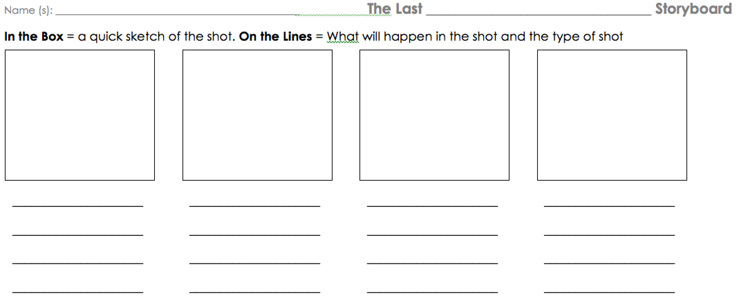
Movie Making as Story Telling

Slide 17
Movie Making Integration
Branch the ‘Last _________’ projects into movie making projects that address ‘hard to make interesting’ learning outcomes in H&C.E., Science, or Social Studies
Example Project: health and career education – career goals – grade five
B1 identify types of work that interest them B2 relate work habits to transferable skills (e.g., effective work habits learned in school can be used in
situations outside of school)

Slide 18
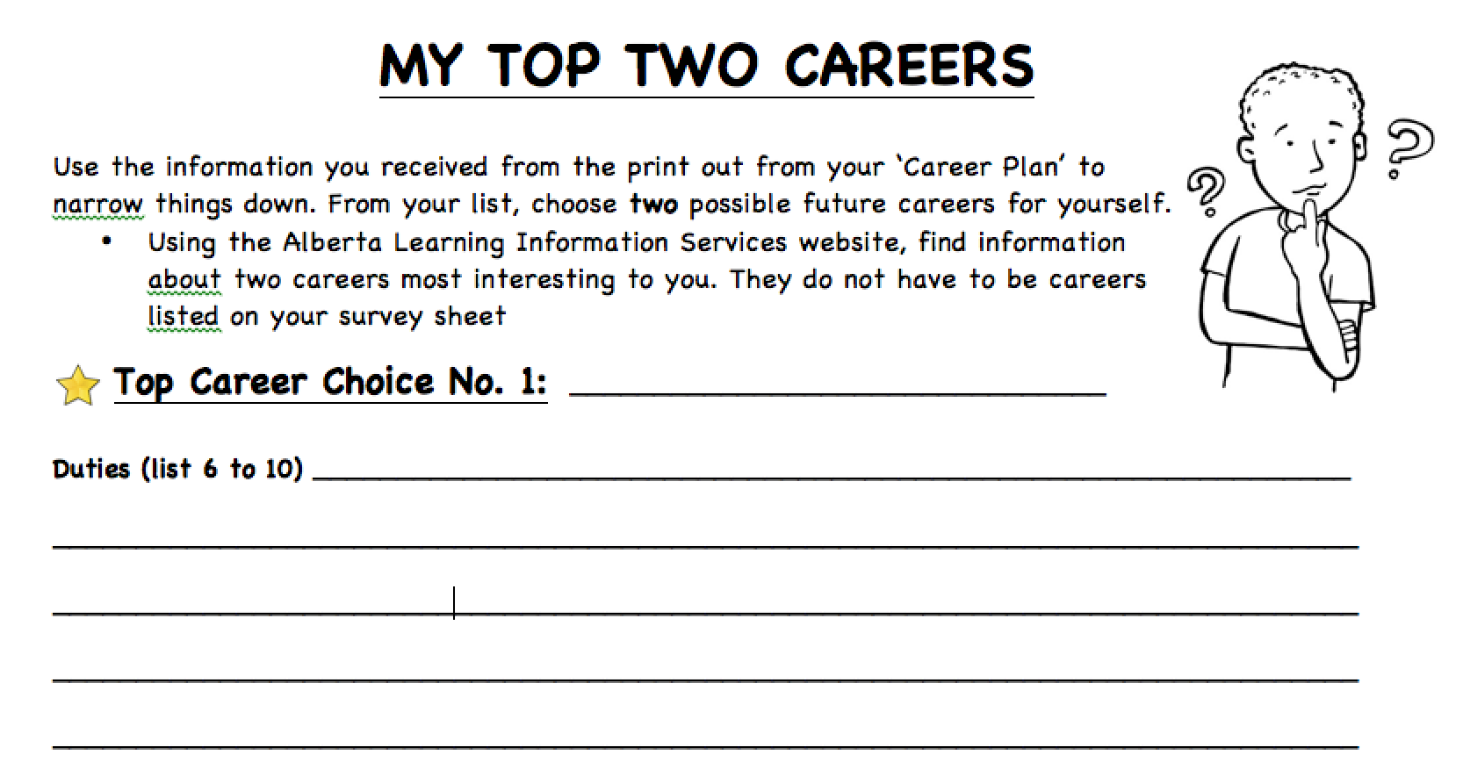
Movie Making Integration

Slide 19
Movie Making Integration

Slide 20
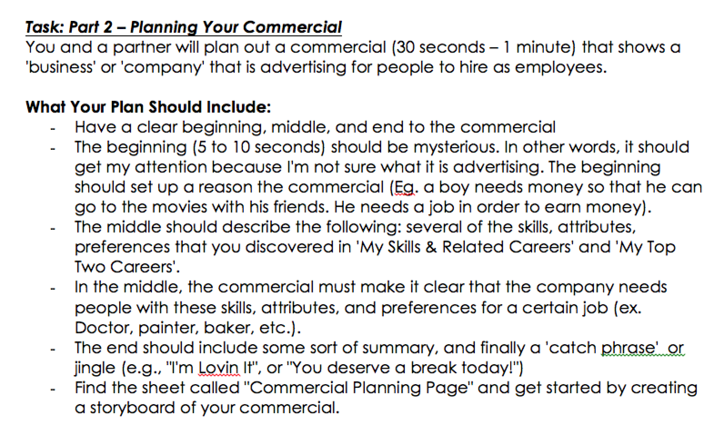
Movie Making Integration

Slide 21
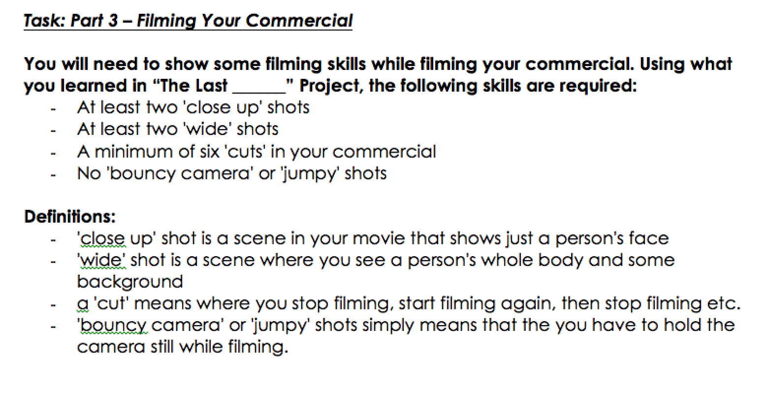
Movie Making Integration

Slide 22
Movie Making Integration

Slide 23
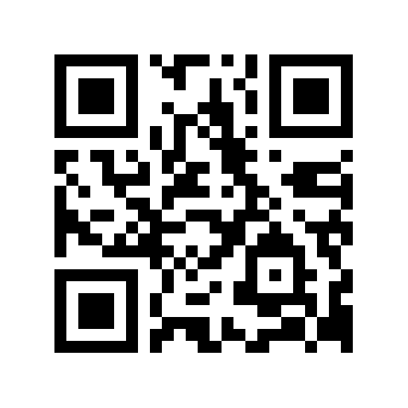
QR codes!!!!!!!!!!

Slide 24
http://qrvoice.net
This website will allow you to input 100 characters of text and will create a QR code for you at the click of a button. Not only are all school laptops equipped with QR code readers (QuickMark) but you can get free readers for mobile devices from the iTunes store.

Slide 25
Potential uses of QR voice….
School Tours
Gallery walk for art projects
Science Fair Projects
Step by Step Directions
Novel / Book Reviews
Can you think of more? Add them to our Today’s Meet site ☺

Slide 26
How could you implement this in your class tomorrow?
Turn to a partner and discuss ways to adapt this activity to your own needs.

Slide 27
Comic Life: Engaging Projects
Students create their own comics without drawing
Another great way to meet those hard to get to learning outcomes in H&C.E., Science, and Social Studies
Example project: health and career education – grade five – substance misuse prevention
A1 describe how various factors (e.g., access to accurate and relevant information, media and social influences) affect decision making
C1 identify factors that influence attitudes and decisions regarding healthy lifestyles (e.g., family, peer, media)
C6 analyse behaviours that contribute to a safe and caring school environment (e.g., taking responsibility for personal actions, supporting others, promoting respect for diversity)
C10 analyse factors that contribute to the use of alcohol, tobacco, and other drugs

Slide 28
Comic Life: Engaging Projects

Slide 29
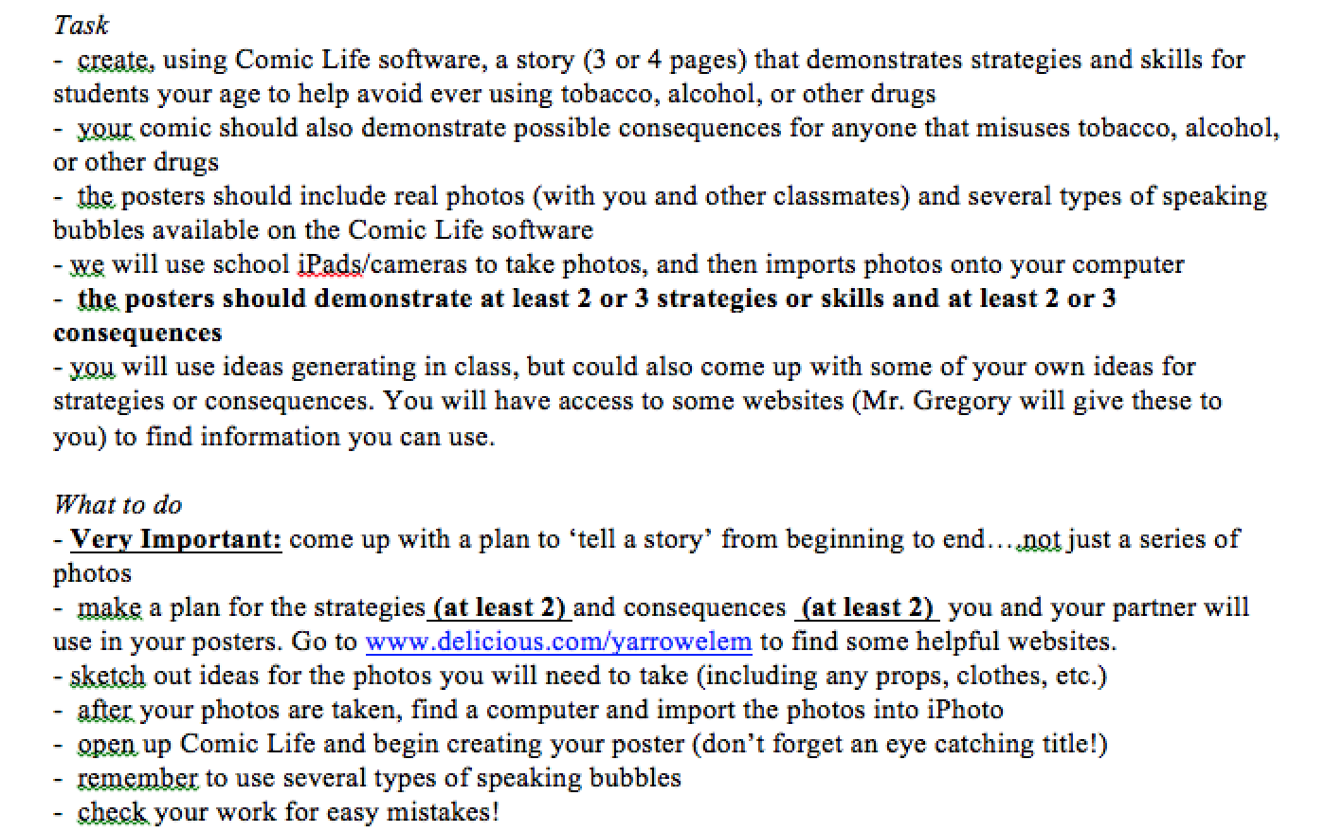
Comic Life: Engaging Projects

Slide 30
Comic Life: Engaging Projects

Slide 31
Education.weebly.com
Students can create ePortfolio’s and blog weekly journal entries instead of keeping paper copies. I’ve worked on this project with students as young as grade 2 and had great success with my own grade 5/6 class creating their own personal websites.
Please note: there are additional safety considerations when students post material online. For a permission form template or to understand some safety considerations, please email me for more information.

Slide 32
Some examples:
http://clesmrssward.weebly.com/

Slide 33
What about a class website as a first step? Good news – you already have one! Ask your administrator for a username and password for your class site attached to your school website (http://cultuslake.sd33.bc.ca/classroom/sward)

Slide 34
Podcasting: Adding Technology to Reader’s Theatre
Podcasting allows students all the benefits of reader’s theatre (reading fluency practice, reading with enthusiasm) and uses digital literacy skills
Students learn/practice recording themselves with an iPad/iPod/computer, building a story on a timeline, editing/cropping sound clips, and adding sound effects or music
http://portableradio.ca/2014/03/01/king-midas-and-the-golden-touch-2/

Slide 35
Overwhelmed yet? 5 minute break???
Come back for some digital citizenship tools and a few of our favourite apps

Slide 36
Why is there a need for digital citizenship?
Twelve Surrey teens disciplined for sharing explicit photos of fellow students ~ The Province, April 17, 2015
Welcome to Shaw Webmail
We have detected some unusual activities Due to security protocols.
You can not receive new messages until you update your mailbox.
Your accounts has now been upgraded and needs to be updated.
It's a few step CLICK HERE to update now.
© 2015 All Rights
Reserved.
SeaWorld Responds To California Drought By Draining Animal Tanks Halfway ~ The Onion, April 18, 2015

Slide 38
Everfi.com
New resource – sponsored by NHL – free for teachers ☺
Not just digital citizenship, but that is a major focus
Many themes and topics are available….new to Canada
A couple of considerations:
The reading level is high….though a lot of it is video based learning or choice based learning…
Some questionable wording is used…
American content base
Really relevant at the middle school level

Slide 40
https://platform.everfi.net/registration/login
Email: Felisha Martin: felisha@everfi.com
@FelishaEverFi 604-499-6562
For your own login and codes for your school

Slide 41
Webonauts Great resource for early learners (grades 2-3 - maybe with help from older buddies for the reading level) Deals with basics of digital citizenships like protecting privacy and passwords, not putting identifying information online
http://pbskids.org/webonauts/

Slide 42
Digital Citizenship in the Intermediate Classroom:
http://ksviudigitalcitizenshipdlf.weebly.com/
Over 60 lesson plans for all ages tied to the Ministry’s draft Digital Literacy Framework

Slide 43
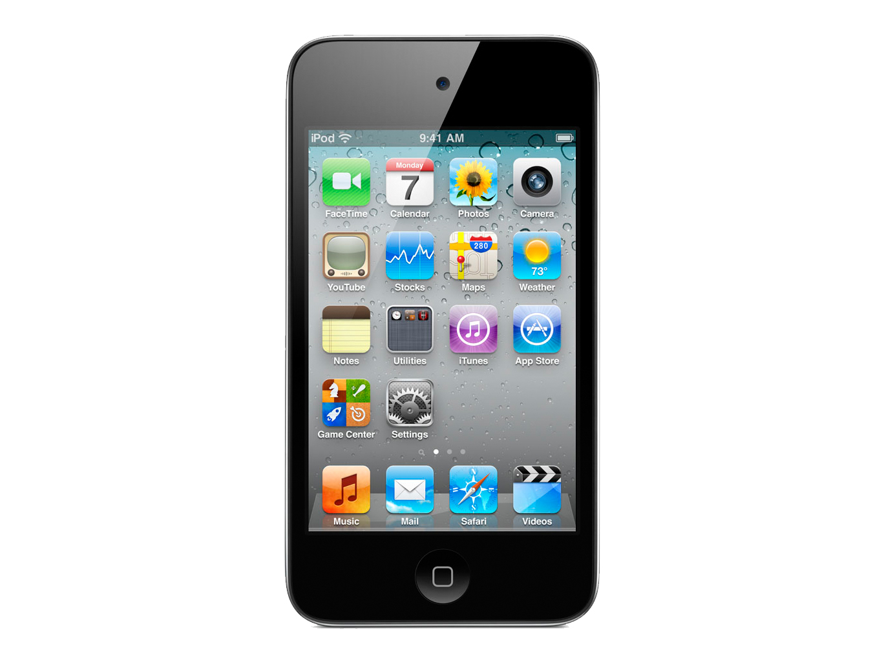
And finally….. …here are a few of our favourite apps…..

Slide 44
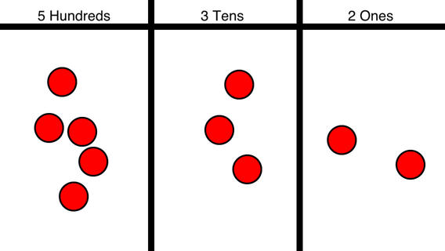
Kris
Choose your topic then search out your apps

Slide 45
Check in with Today’s Meet
https://www.youtube.com/watch?v=JnBRjeR105g

Slide 46
Some Parting Thoughts….
Tech will always have glitches….But just as you would tell your students to breathe, problem solve and figure it out, give yourself that reassurance as well. Take a moment, laugh about it and ask the kids to help figure it out….
1) it takes the pressure off you to solve it right away,
2) you are collaborating and learning together
3) you are empowering your students and will get them excited about their learning
Go for it! You don’t have to be an expert. Be open to trying it, make a few mistakes, work things out and build your confidence…..you can do this….believe it!

Slide 47
Still not sure?
No worries – you have a team of Educational Technology Facilitators at your disposal! We can come into your classroom to help with an existing project, share our ideas or support you in your teaching and learning.
Scott Gregory scott_gregory@sd33.bc.ca
Kris Sward kristin_sward@sd33.bc.ca
Jeff Campbell jeff_campbell@sd33.bc.ca
Hugh Longhurst hugh_longhurst@sd33.bc.ca
Upcoming dates that might be available:
May 19th, 21st
June 1st, 8th, 15th

Slide 48
Questions? Comments? Concerns??
Thank you for coming and sharing your morning with us!!

